Slide 1
Natural Language Processing

Slide 2
Agenda
What is NLP?
Applications of NLP
NLP Libraries
Text Pre Processing Techniques
NLTK, Spacy, Text Blob, Stanford NLP
String Similarity
Projects

Slide 3
Project details
Spam classifier
or
Netflix sentiment
or
Twitter sentiment
Assignment – fake news detection

Slide 4
What is Natural Language?

Slide 5
Any language in which humans are making a conversation that language is the Natural language

Slide 6
What is NLP ?
Natural language processing (NLP) is a field of artificial intelligence in which computers analyze, understand, and derive meaning information from human language in a smart and useful way

Slide 7
By utilizing NLP, developers can organize and structure knowledge to perform tasks such as automatic summarization, translation, named entity recognition, relationship extraction, sentiment analysis, speech recognition, and topic segmentation.

Slide 8
Application of NLP

Slide 9
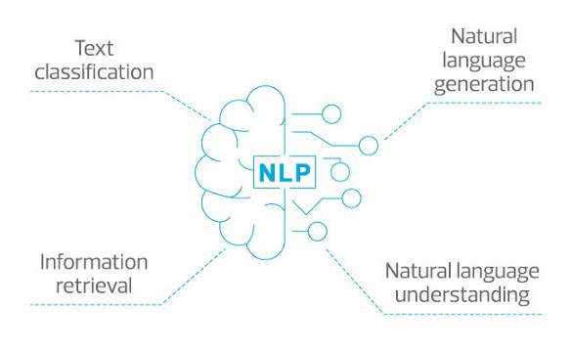

Slide 10
Optimize customer service
- providing answers faster (through the web, chatbots, or voice applications like smart speaker apps)
- NLP allows companies to spend less on human service agents, office spaces, phones, and other costs.

Slide 11
Learn from customer data
NLP lets companies glean more insights from customer data regardless of its source, size, or format.

Slide 12
Augment text-intensive tasks
Automating task using NLP-based applications.
- This has already been successfully applied to spam detection
- categorizing heaps of resumes via automation.

Slide 13
Search beyond keywords
Applying NLP to search produces results based on an understanding of the meaning of the query instead of just by matching the keywords.

Slide 14
NLP Libraries
NLTK ( Natural Language Tool-Kit)
Text Blob
Spacy
Stanford NLP

Slide 15
Text Analytics/ Text Mining

Slide 16
It is process of deriving the meaningfull information from the natural languages text

Slide 17
Text Analytics is Nothing but the preprocessing that is required before giving the data to the model

Slide 18
In Machine learning we have data preprocessing
In NLP we called it as text analytics

Slide 19
Tokenization
There are two parts
1. Sentence tokenization
2. word tokenization

Slide 20
But why we need Tokenization?

Slide 21
Because NLP algorithm works on the weights of the word

Slide 22
But How this weigths are calculated?

Slide 23
This a based on how many times the word is occuring in a sentence ( count of word in sentence or document
Methods to do so – TF-IDF , Bag of words

Slide 24
Example in user comments
- if the count of the words like happy , satisfied and good occured for more number of times then that means that its a positive sentence
-if the count of the words like sad , not-satisfied and bad occured for more number of times then that means that its a negative sentence

Slide 25
Lets see tokenization with the help of coding

Slide 26
POS(Parts of speech) tagging

Slide 27
Once we have tokenized our word then the next step is to identify that which part of speech that sentence belongs to

Slide 28
Lets see the code

Slide 29
Stopwords

Slide 30
Stop words are such words which are very common in occurrence such as ‘a’,’an’,’the’, ‘at’ etc
We ignore such words during the preprocessing part since they do not give any important information and would just take additional space

Slide 31
We can make our custom list of stop words as well if we want
Different libraries have different stop words list. Let’s see the stop words list for NLTK

Slide 32
Code.............

Slide 33
Remove Punctuation

Slide 34
We want to Our Model to Understand the meaning of the word
- First lets see how we human understand the meaning of the word?

Slide 35
We understand the meaning of the word by associating it with the root word

Slide 36
Suppose we say......
Run
Running
Ran
So in these three words what are we taking about or what comes into your mind?

Slide 37
We are just talking about an action called as Run

Slide 38
Now again suppose we say.....
See
Saw
Seen
Seeing
Sees
- so what comes into your mind?

Slide 39
- so action is same, that is see

Slide 40
This is how we human understand right?
So based on the form of the verb we get extra information that whether the action happend in past , future or still going on.

Slide 41
Based on the suffixes we undestand that when is the action happening but action is same

Slide 42
So our NLP Alogrithm tries to understand that what action are we talking about
And to identify this we have to two process

Slide 43
Stemming And Lemmatization
Process of removing inflected in words to their Word stem or root from

Slide 44
Stemming
Bringing word in the stem form

Slide 45
Stemming means mapping a group of words to the same stem by removing prefixes or suffixes without giving any value to the “grammatical meaning” of the stem formed after the process.

Slide 46
- history
- histori
- historical

Slide 47
-finally
- final ---------> fina
- finalized

Slide 48
- going
- goes -----------> go
- gone

Slide 49
Lemmatization
Bringing the word to lemma form

Slide 50
Lemmatization also does the same thing as stemming and try to bring a word to its base form, but unlike stemming it do keep in account the actual meaning of the base word

Slide 51
- history
-----> history
- historical

Slide 52
- finally
- final ---------> final
- finalized

Slide 53
- going
- goes -----------> go
- gone

Slide 54
Stemming vs lemmatization

Slide 55
Stemming is chopping out the word into the stem form but the chopped word can or cannot have a meaning
Lemmatization also does the same thing as stemming but the only difference is the final root form of the word will always have a meaning

Slide 56
Lemmatization usually takes a lot of time because to get a meaning full word it requires lot of processing and it has to understand the sentences before generating the root form
Stemming is faster because its job is to just give the base / root word without understading the meaning or context

Slide 57
We use stemming in those use-cases where the meaning of the word is not important
for eg – sentiment analysis, +ve/-ve sentences,
spam classifier
We use lemmatization in those use-cases where the meaning and context of the word is important
for eg – chatbot , question/answer application

Slide 58
NER(Name entity Recognition)

Slide 59
NER is used in many fields in Natural Language Processing (NLP), and it can help answering many real-world questions, such as:

Slide 60
NER is the first step towards information extraction that seeks to locate and classify named – entities in the text into pre-defined categories such as name of the person, organizations
In NER, we try to group entities like people, places, countries, things etc. together.

Slide 61
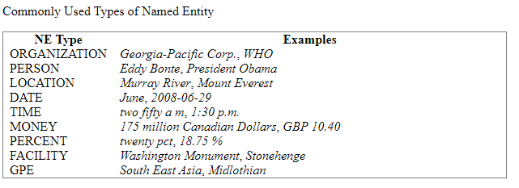

Slide 62
Which companies were mentioned in the news article?
Were specified products mentioned in complaints or reviews?
Does the tweet contain the name of a person? Does the tweet contain this person’s location?

Slide 63
TextBlob: Simplified Text Processing

Slide 64
Features
Noun phrase extraction
Part-of-speech tagging
Sentiment analysis
Classification (Naive Bayes, Decision Tree)
Language translation and detection powered by Google Translate
Tokenization (splitting text into words and sentences)
Word and phrase frequencies
Parsing
n-grams
Word inflection (pluralization and singularization) and lemmatization
Spelling correction
Add new models or languages through extensions
WordNet integration

Slide 65
Installation
Installing/Uploading from the PyPi
pip install textblob
python -m textblob.download_corpora

Slide 66
Text blob is build over NLTK library

Slide 67
A big advantage of this is, it is easy to learn and offers a lot of features like sentiment analysis, pos-tagging, noun phrase extraction, etc.

Slide 68
A good thing about TextBlob is that they are just like python strings. So, you can transform and play with it same like we did in python.

Slide 69
Pros
Since, it is built on the shoulders of NLTK and Pattern, therefore making it simple for beginners by providing an intuitive interface to NLTK.
It provides language translation and detection which is powered by Google Translate ( not provided with Spacy).

Slide 70
Cons
It is little slower in the comparison to spacy but faster than NLTK. (Spacy > TextBlob > NLTK)
It does not provide features like dependency parsing, word vectors etc. which is provided by spacy.

Slide 71
Now we need a way to represent text data for machine learning algorithm

Slide 72
Bag of Words
The bag-of-words model is simple to understand and implement. It is a way of extracting features from the text for use in machine learning algorithms.

Slide 73
In this approach, we use the tokenized words for each observation and find out the frequency of each token.

Slide 74
Step1 - Collecting Data
It was the best of times,
it was the worst of times,
it was the age of wisdom,
it was the age of foolishness,
For this small example, let’s treat each line as a separate “document” and the 4 lines as our entire corpus of documents.

Slide 75
Step2
We treat each sentence as a separate document and we make a list of all words from all the four documents excluding the punctuation. We get,

Slide 76
‘It’, ‘was’, ‘the’, ‘best’, ‘of’, ‘times’, ‘worst’, ‘age’, ‘wisdom’, ‘foolishness’

Slide 77
Step 3
We take the first document — “It was the best of times” and we check the frequency of words from the 10 unique words.

Slide 78
“it” = 1
“was” = 1
“the” = 1
“best” = 1
“of” = 1
“times” = 1
“worst” = 0
“age” = 0
“wisdom” = 0
“foolishness” = 0

Slide 79
Rest of the documents will be:
“It was the best of times” = [1, 1, 1, 1, 1, 1, 0, 0, 0, 0]
“It was the worst of times” = [1, 1, 1, 0, 1, 1, 1, 0, 0, 0]
“It was the age of wisdom” = [1, 1, 1, 0, 1, 0, 0, 1, 1, 0]
“It was the age of foolishness” = [1, 1, 1, 0, 1, 0, 0, 1, 0, 1]

Slide 80
The process of converting NLP text into numbers is called vectorization

Slide 81
This results in a vector with lots of zero scores called a sparse vector or sparse representation

Slide 82
Sparse vectors require more memory and computational resources when modeling and the vast number of positions or dimensions can make the modeling process very challenging for traditional algorithms.

Slide 83
As such, there is pressure to decrease the size of the vocabulary when using a bag-of-words model.

Slide 84
Step – Cleaning Data
best times
Worst times,
age wisdom,
age foolishness
remove stop words , punctuation etc to get the clean data

Slide 85
TF-IDF
Term Frequency and Inverse Document Frequency

Slide 86
TF-IDF is useful in solving the major drawbacks of Bag of words by introducing an important concept called inverse document frequency.

Slide 87
It’s a score to highlight each word’s relevance in the entire document

Slide 88
Formula
Tf = No. of rep of words in sentence / no. of words in sentence
Idf = log(no. of sentences/ no. Of sentence containing words)

Slide 89
TF answers questions like — how many times is beauty used in that entire document, give me a probability and
IDF answers questions like - how important is the word beauty in the entire list of documents, is it a common theme in all the documents.

Slide 90
Let’s cover an example of 3 documents -
Document 1 - It is going to rain today.
Document 2 - Today I am not going outside.
Document 3 - I am going to watch the season premiere.
To find TF-IDF we need to perform the steps we laid out above, let’s get to it.

Slide 91
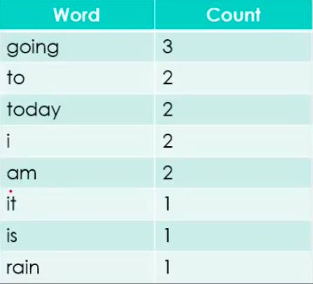
Step 1 Clean data and Tokenize

Slide 92
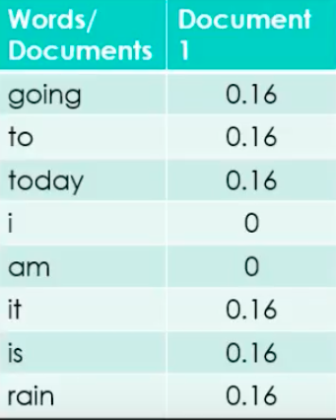
Step 2 Find TF
It is going to rain today.

Slide 93
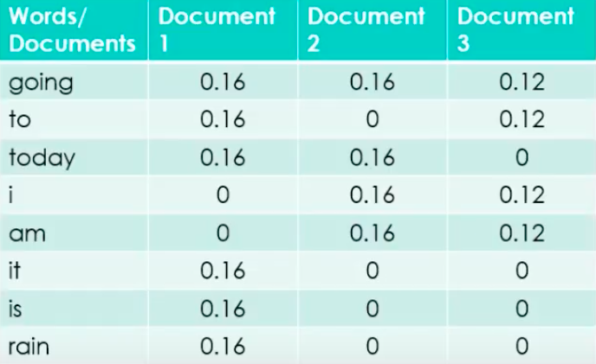
Continue for rest of sentences -

Slide 94
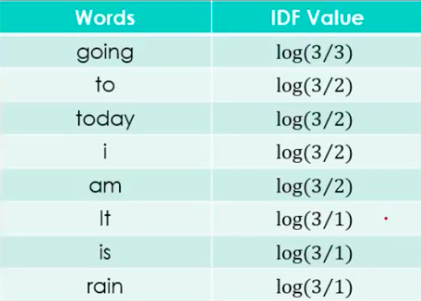
Step 3 Find IDF

Slide 95
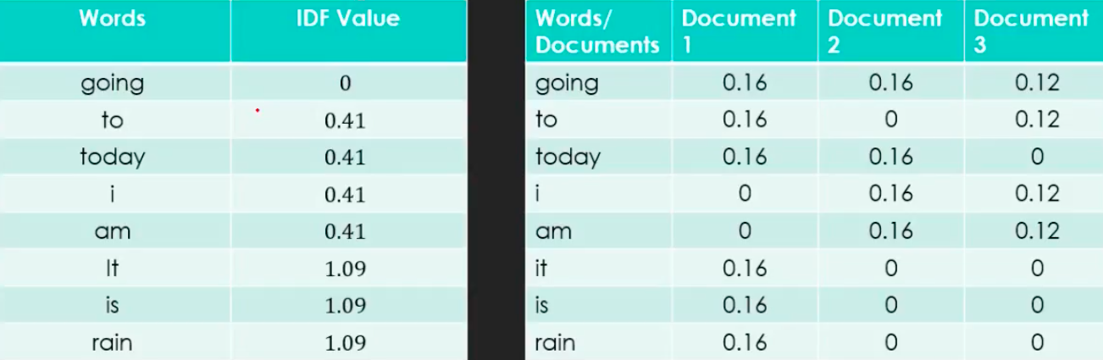
Step 4 Build model i.e. stack all words next to each other

Slide 96
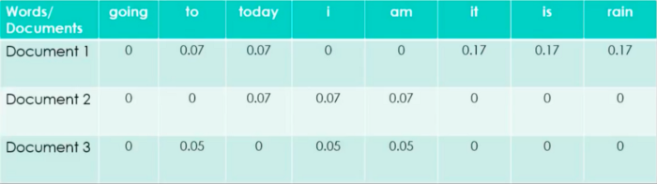
Step 5 - tf*idf

